Slide 1
Google Search
By Mohamed Ahmed Ali

Slide 2
Framework Features
1- Page Object Model
2- Data Driven Model
3- Reporting features : allure , logging, screenshot
4- Voice library
5- TestNG annotations
6-Integration with Jenkins
7-Integration with Docker

Slide 3
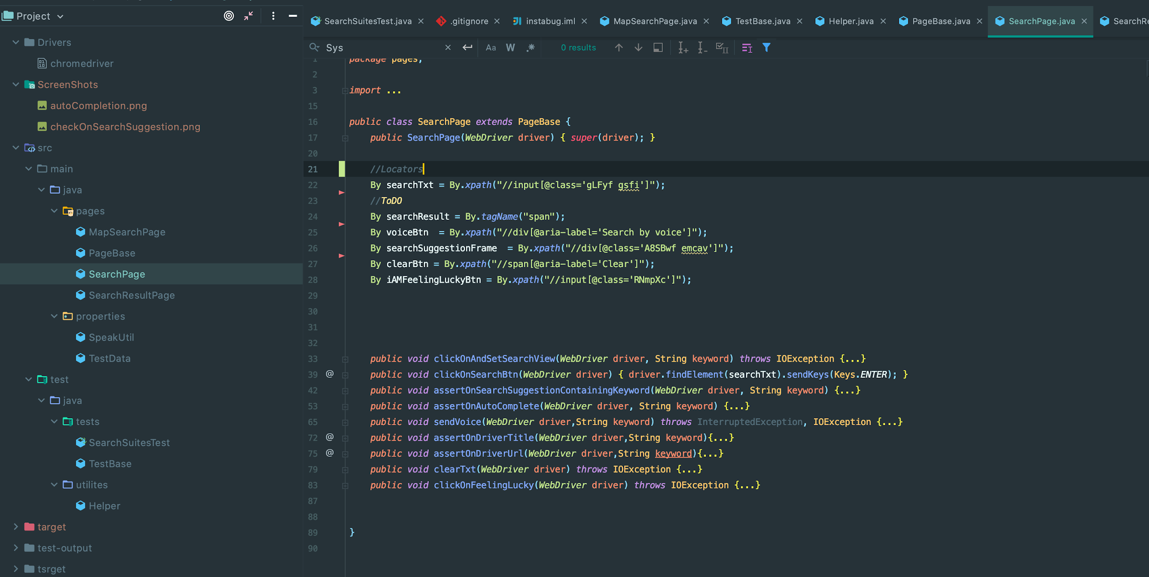
Page Object Model

Slide 4
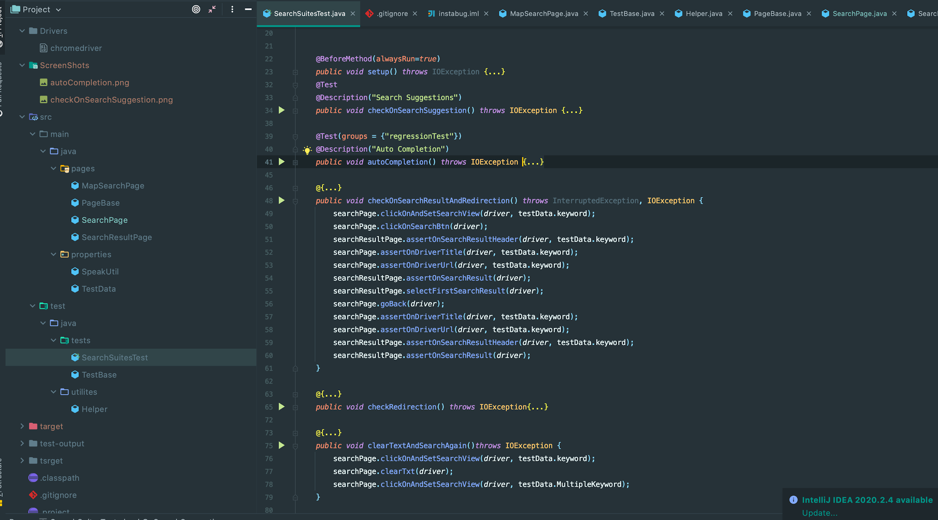
Data Driven Model

Slide 5
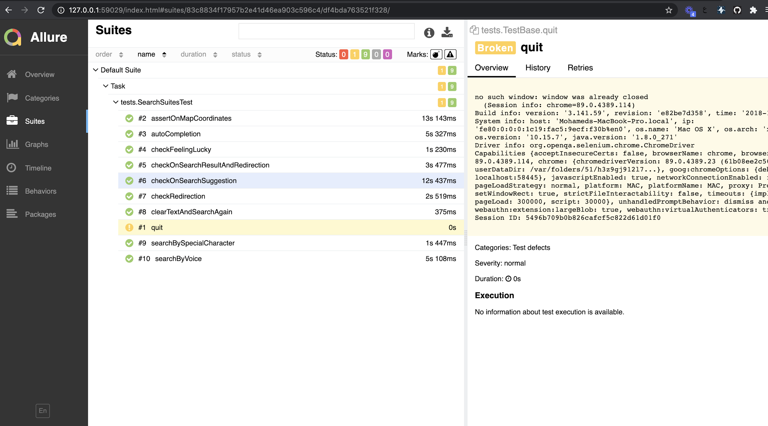
Allure Reports

Slide 6
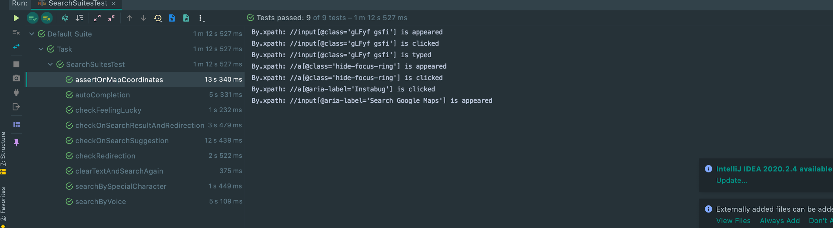
Logging

Slide 7
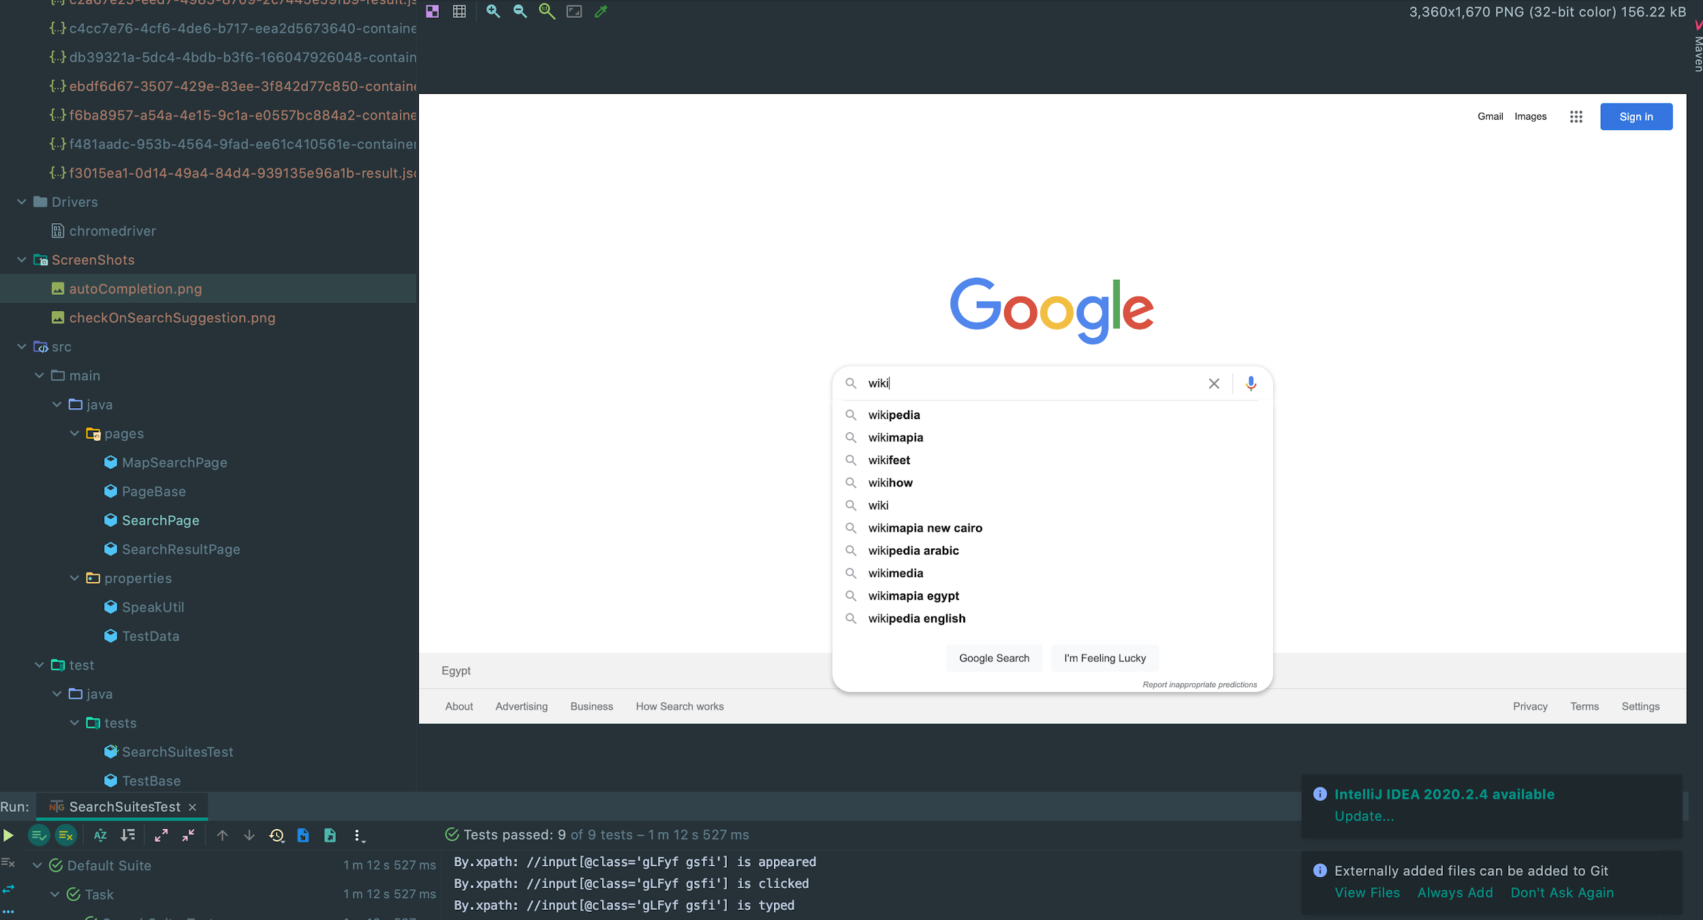
ScreenShot on Failure

Slide 8
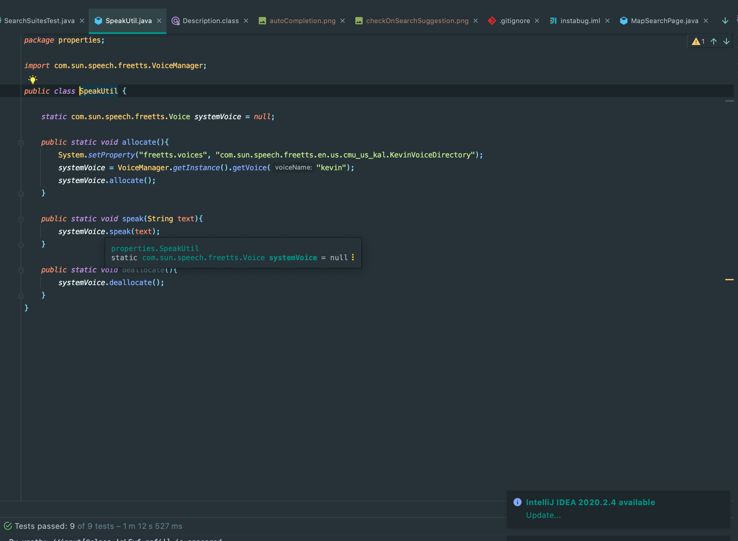
Dealing with search by voice

Slide 9
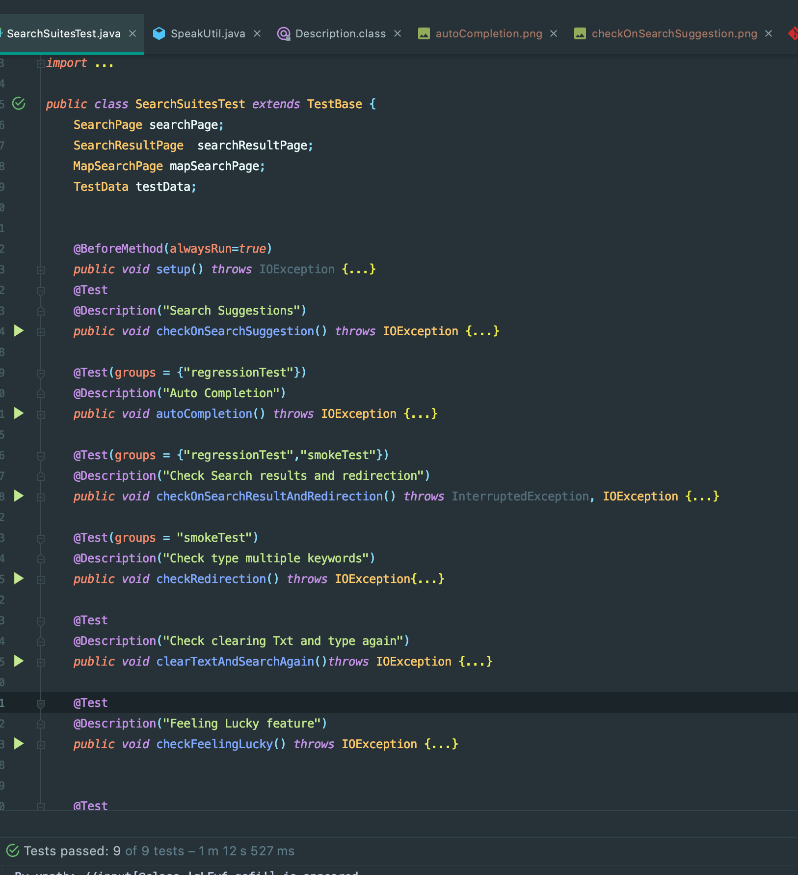
TestNG annotation

Slide 10
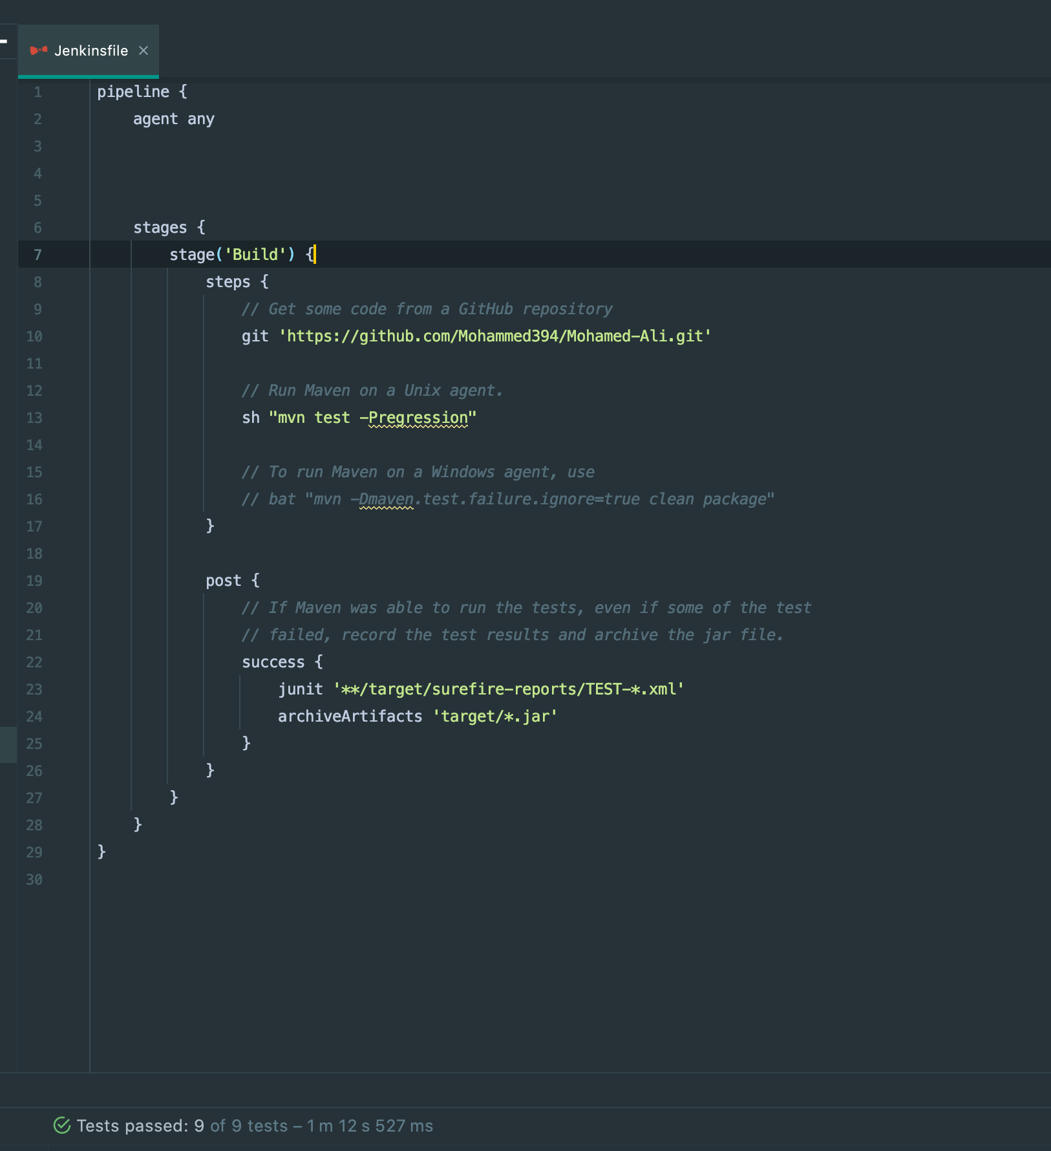
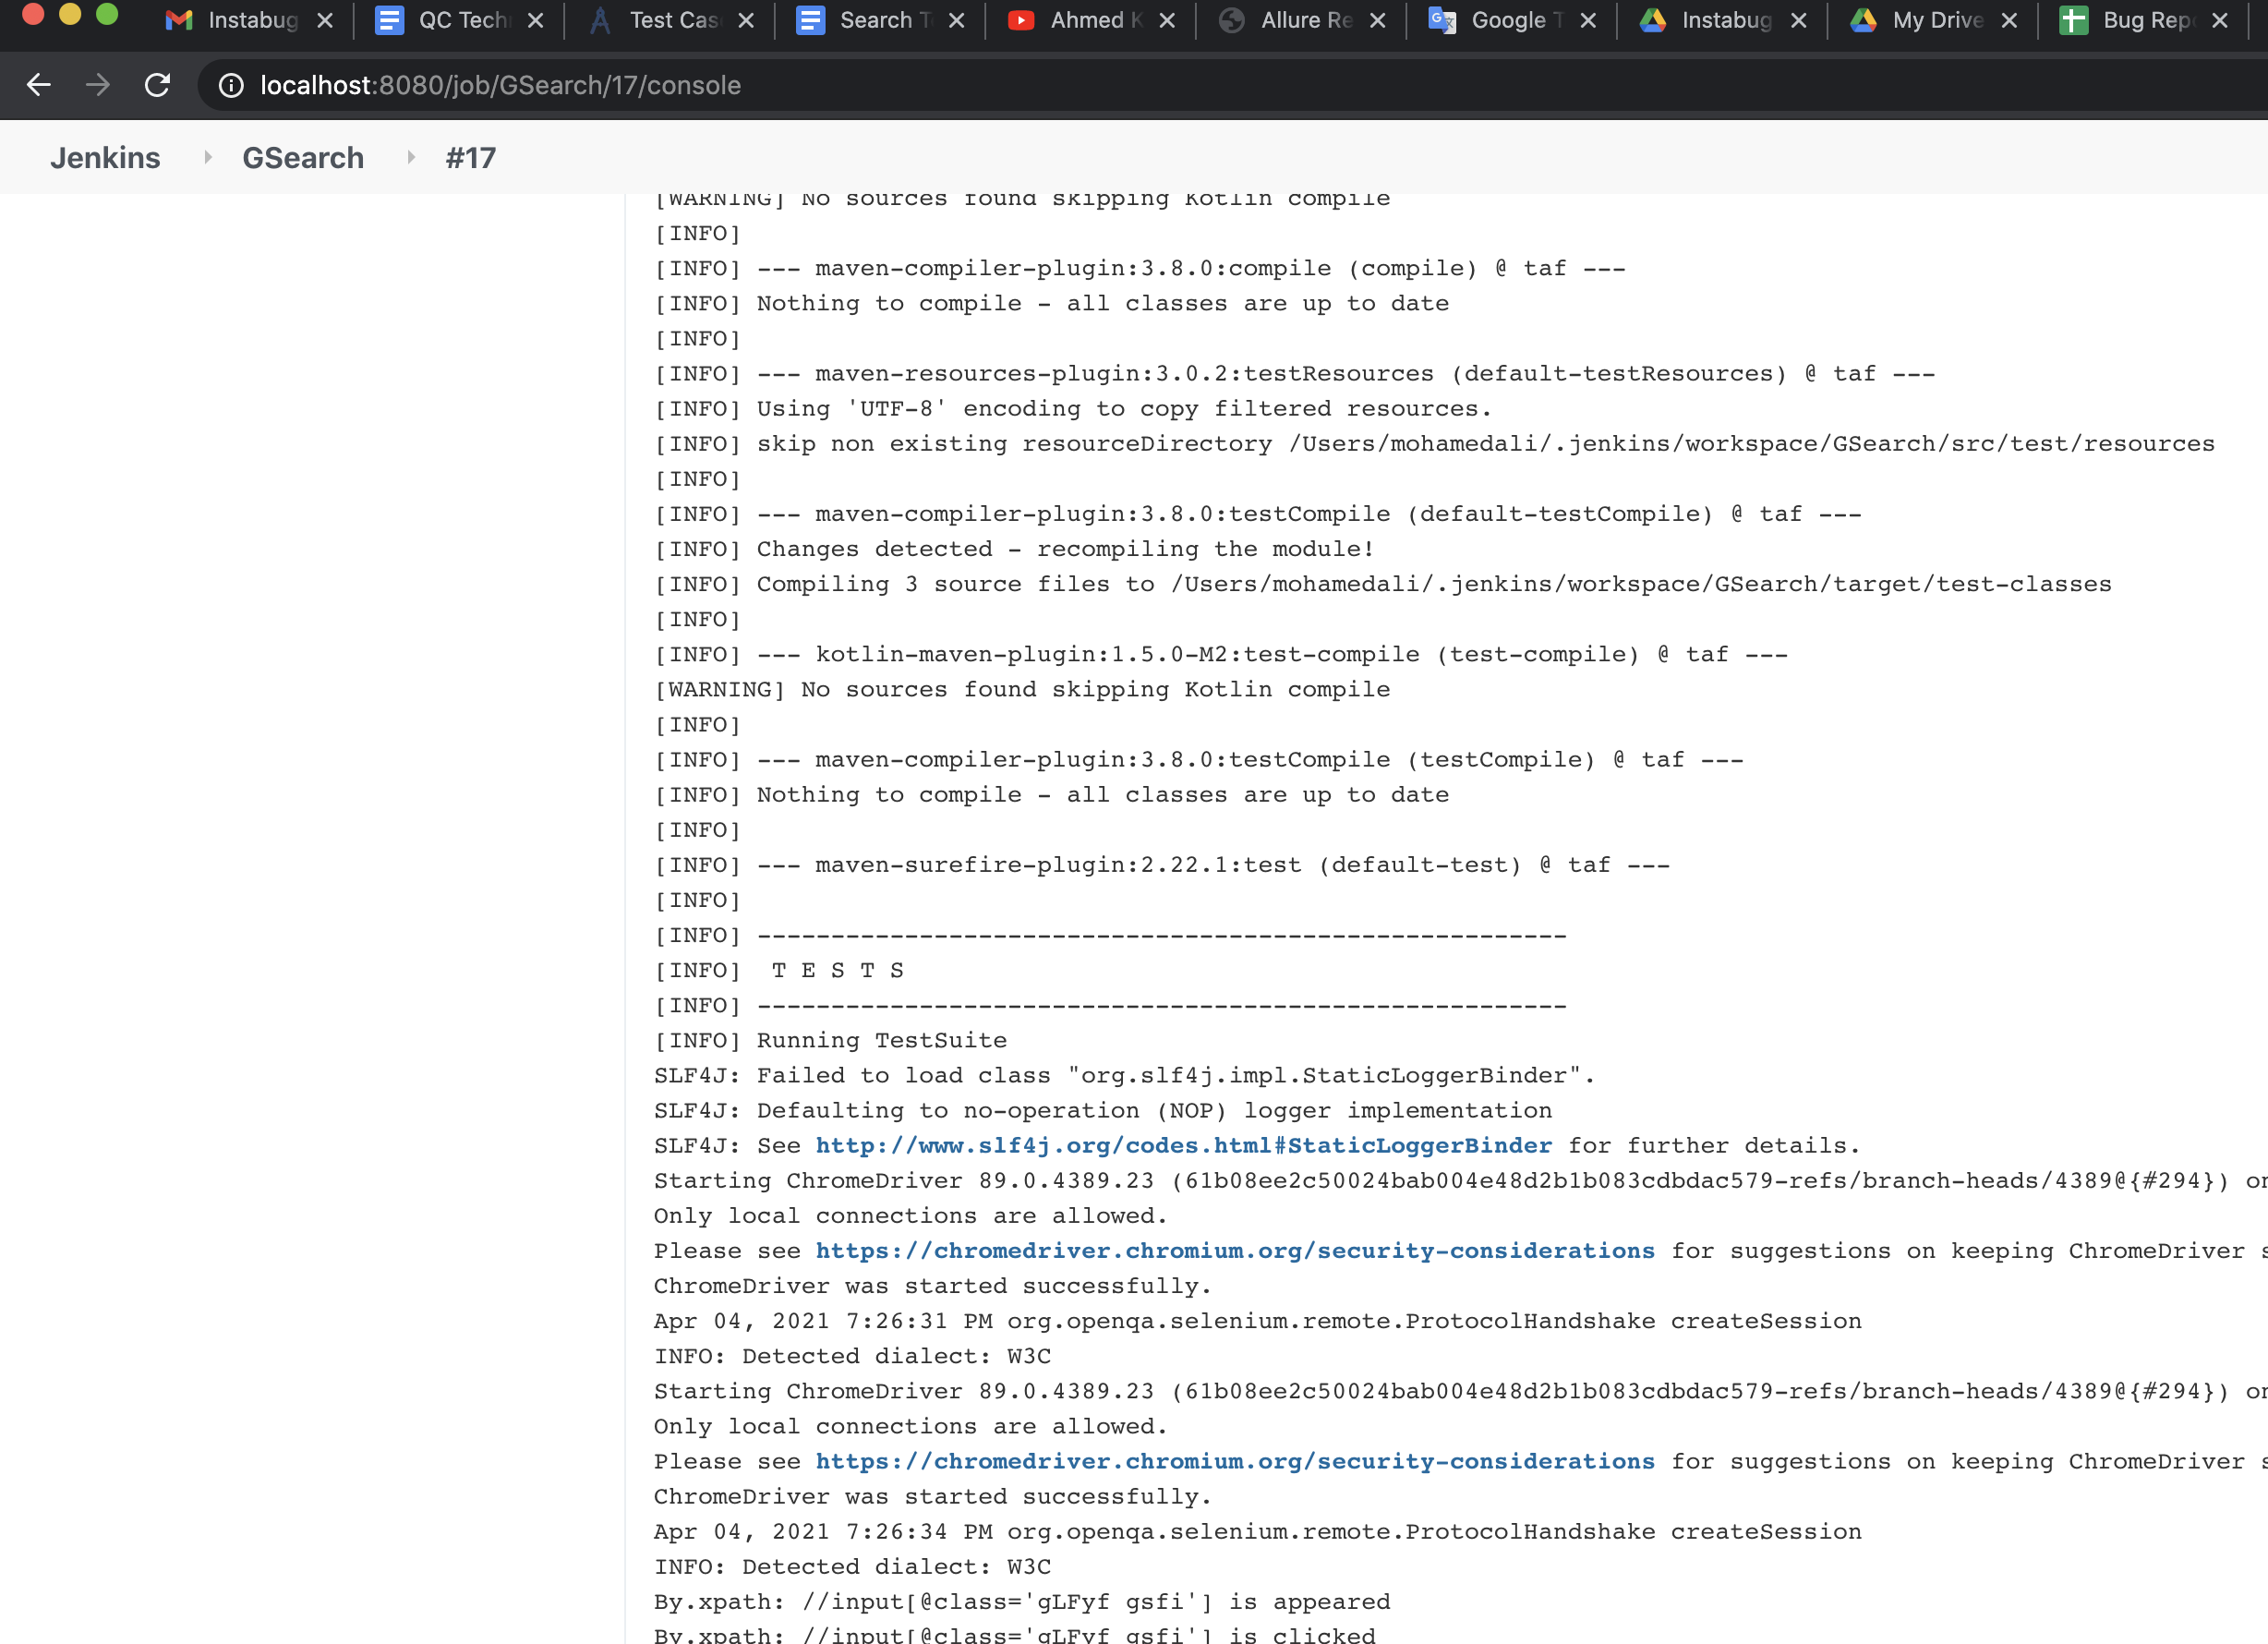
Integration with Jenkins

Slide 11
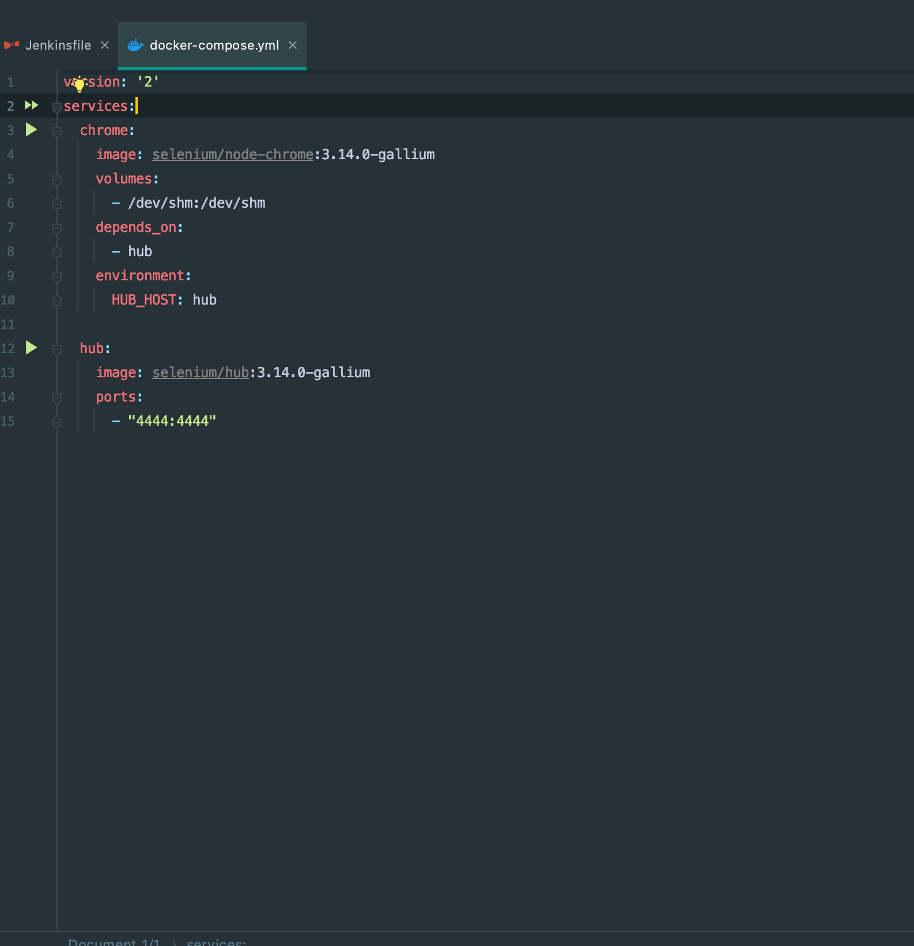
Integration with Docker (using Docker Compose)

